Slide 1
Compound Booleans
Mr. Neat
Java

Slide 2
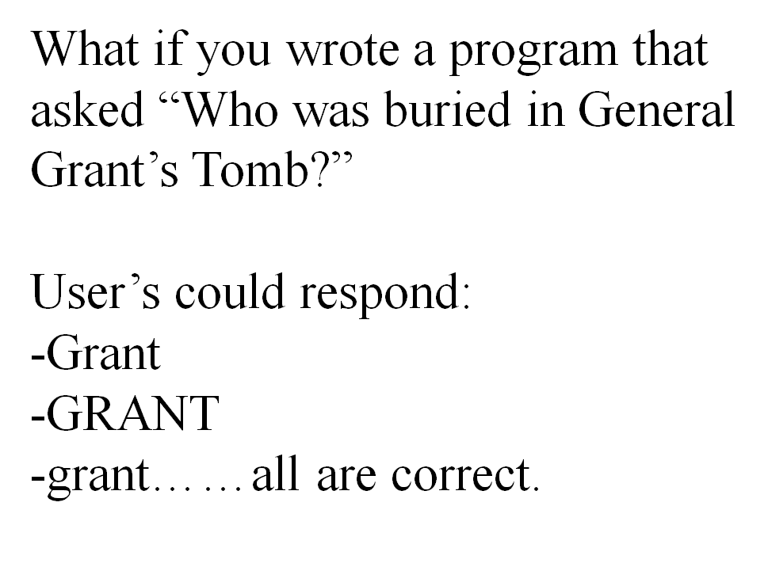
Compound Booleans

Slide 3
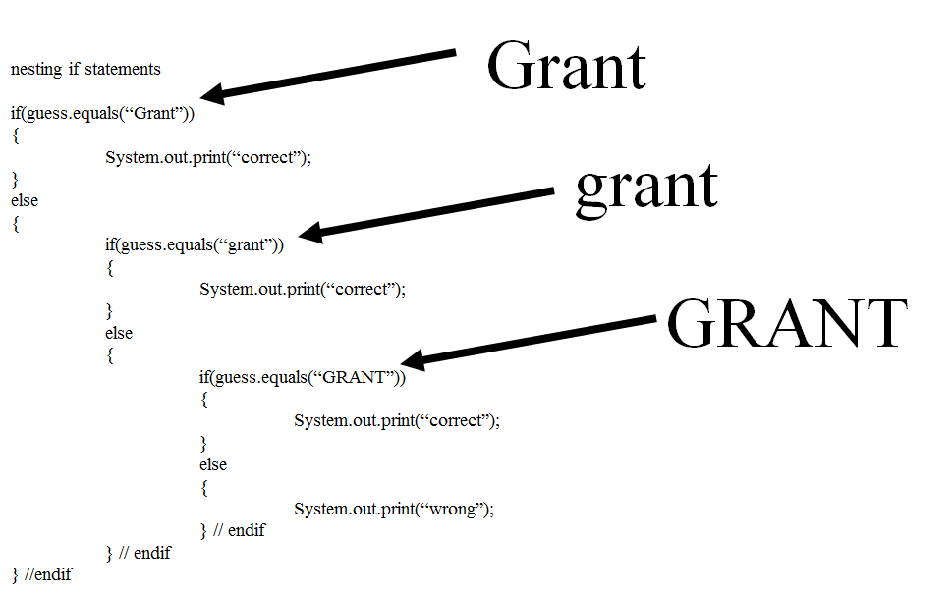
Using what you know...

Slide 4
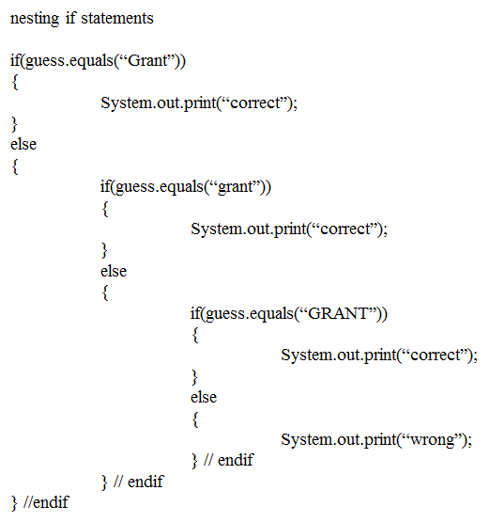
Using what you know...
This is called
“nesting” if statements

Slide 5
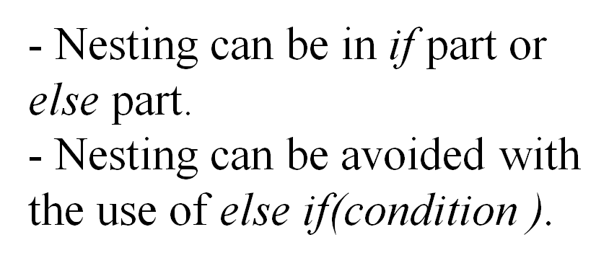
else if statements

Slide 6
Something new:
else if statements
if(boolean)
{
}
else if(boolean)
{
}
else if(boolean)
{
}
else
{
}
only one of these will fire

Slide 7
Something new:
Compound Booleans
if(guess.equals(“grant”)||guess.equals(“Grant”))
{
System.out.println(“correct”);
}
first boolean
second boolean
|| means OR

Slide 8
Something new:
Compound Booleans
if(guess.equals(“grant”)||guess.equals(“Grant”))
can have as many booleans as you want
only one has to be true for the whole boolean to be true
Java stops evaluating the booleans as soon as it finds a true boolean (short circuiting)

Slide 9
Something new:
Compound Booleans
Also have an “and” boolean....&&
int ex = 55;
int why = 17;
if(ex > 100 && why < 200)
{
System.out.println(“pizza”);
}

Slide 10
Something new:
Compound Booleans
if(ex > 100 && why < 200)
can have as many booleans as you want
all booleans have to be true for the whole boolean to be true
Java stops evaluating the booleans as soon as it finds one false boolean (short circuiting)

Slide 11
Lab
Add another drive method to your Car class
The header is:
public void driveRandom()
This method:
moves the Car one step
recycles the Car when the Car goes off the screen to the right
if the Car goes off the top or bottom of the screen, the y recycle location is the upper left corner of the screen
if the y location at the time of recycling is anywhere else (any road) then the y recycle location should be a random choice between:
same road it was just on
the road above it
the road below it
- Test it with 2 Car objects and SOP their y locations

